Slide 1



Slide 2
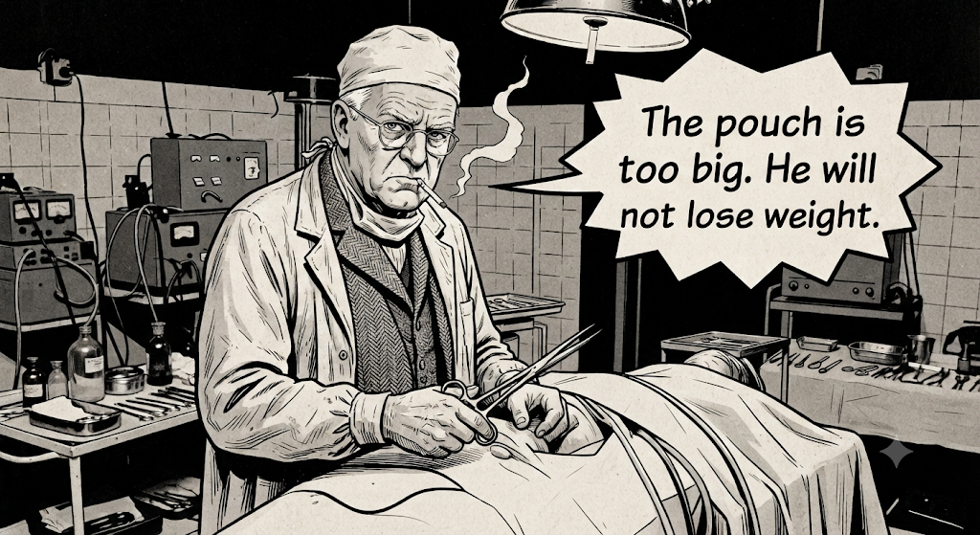

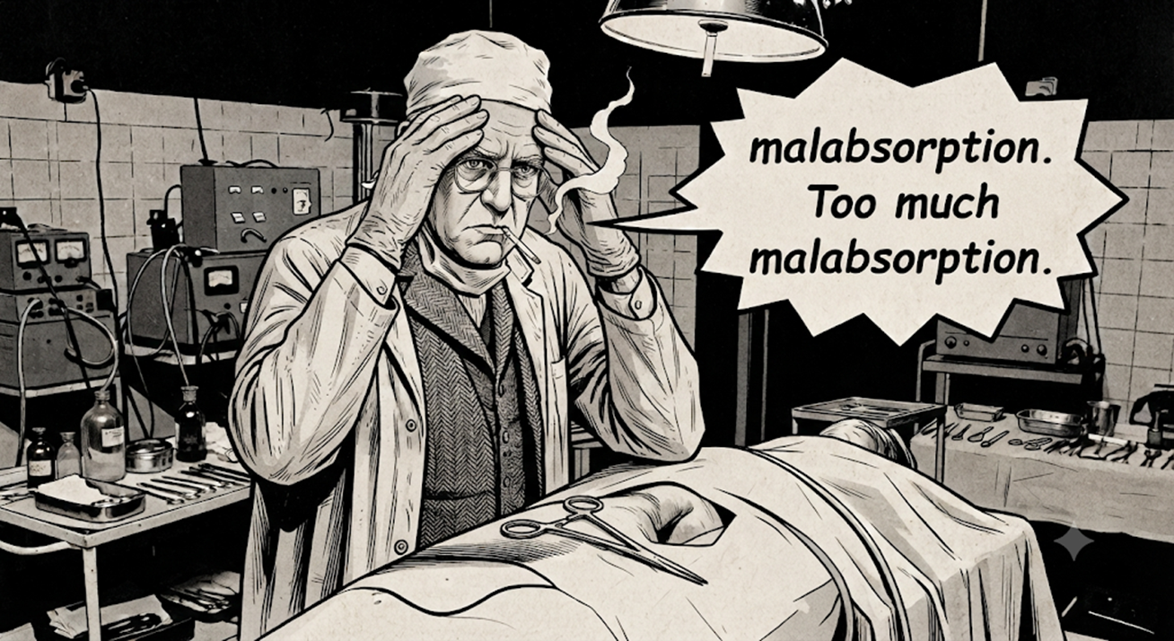


Slide 3
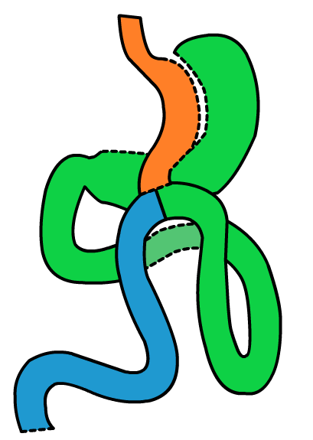
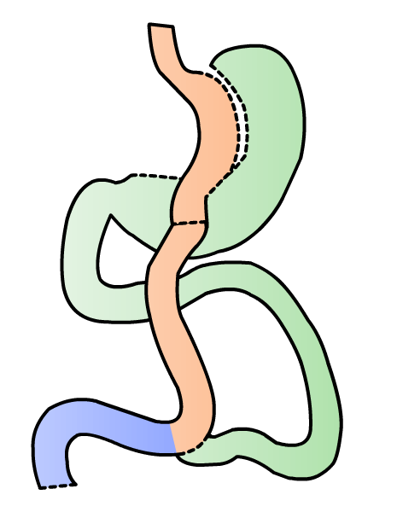
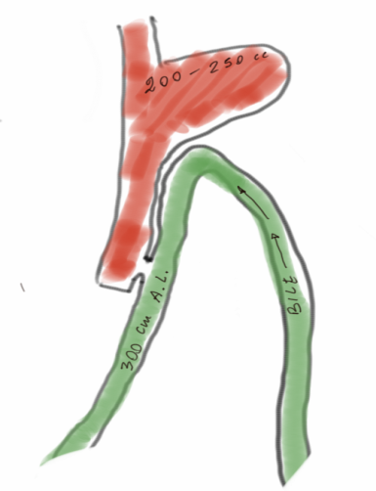
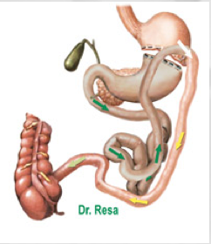
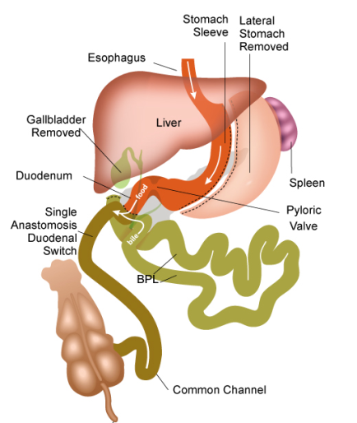
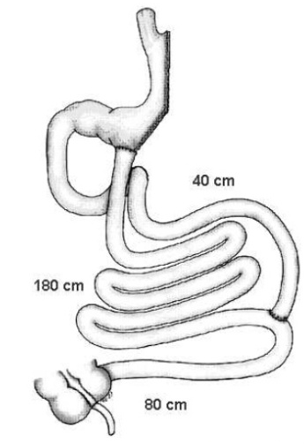
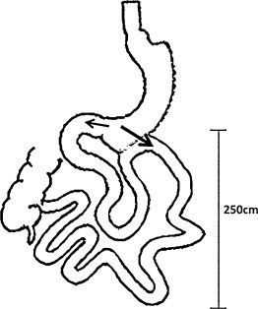
The Ileal stimulation (Billroth II reconstruction) is the main mechanism of action of modern metabolic surgeries
MINIGASTRIC BYPASS - MGB
(Robert Rutledge)
Diverted MGB - dMGB
(Rui Ribeiro)
BYPASS GASTRO-ILEAL
(Joaquín Resa)
ILEAL FOOD DIVERSION
(Francesco Greco)
Loop duodenojejunal bypass with sleeve gastrectomy
(C.K Huang)
SADI-DS
(Andres Sanchez Pernaute)
SASI
(Tarek Mandy)
TRANSIT BIPARTITION
(Andres Sanchez Pernaute)

Slide 4


Slide 5


Slide 6
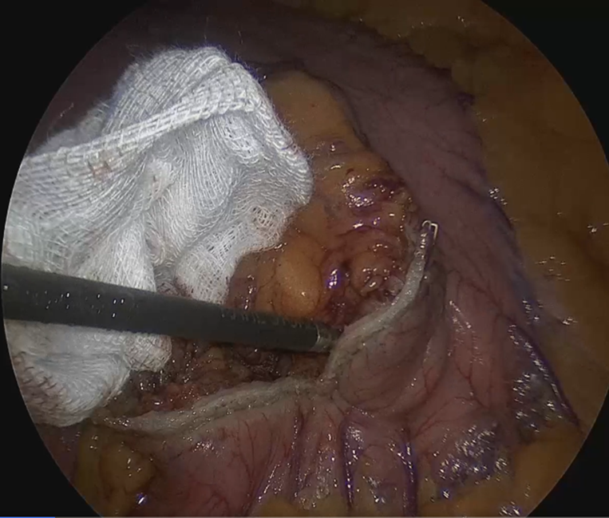
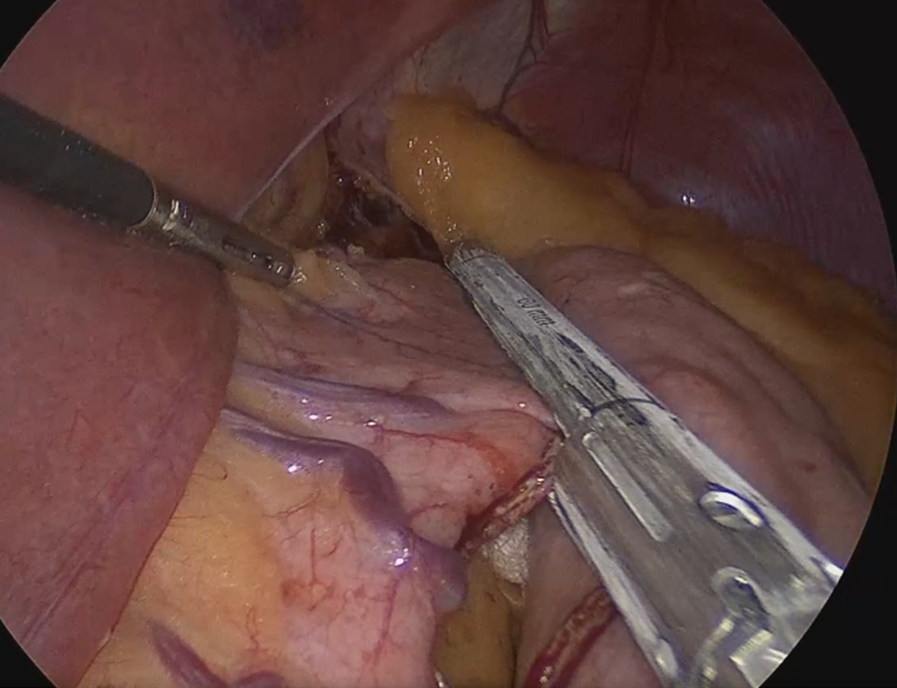
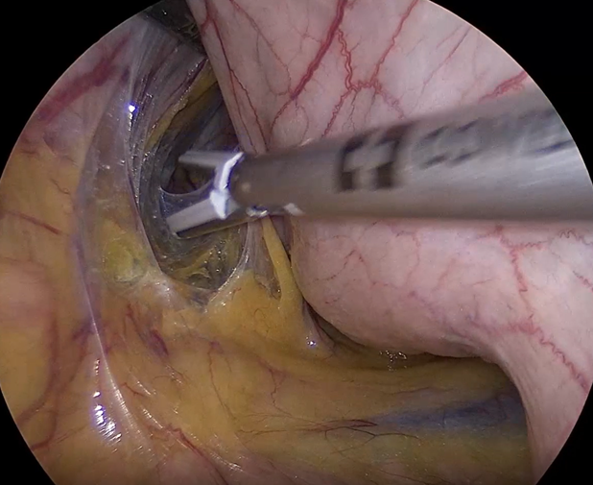

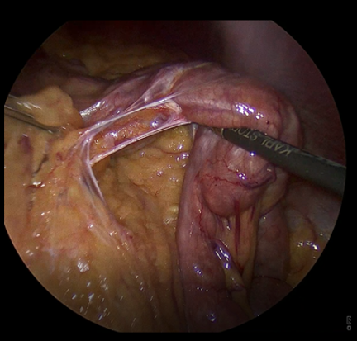
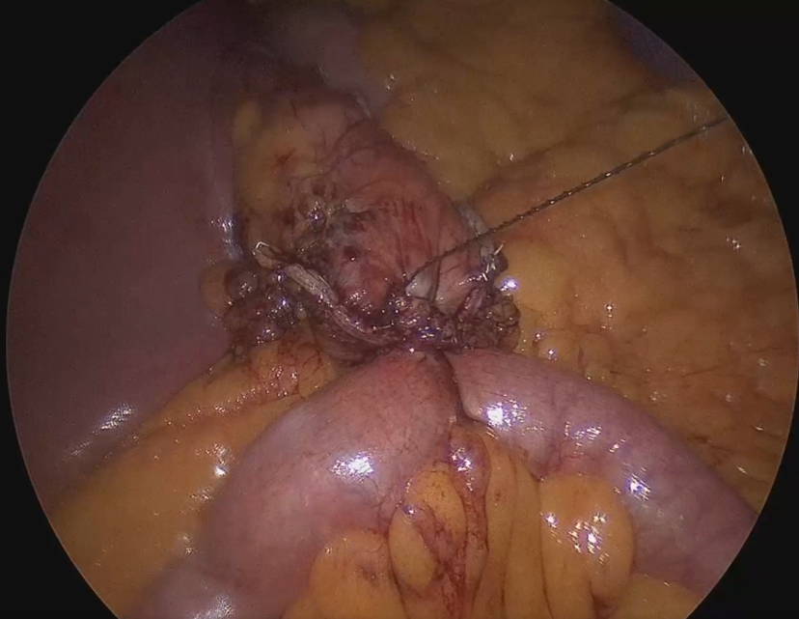
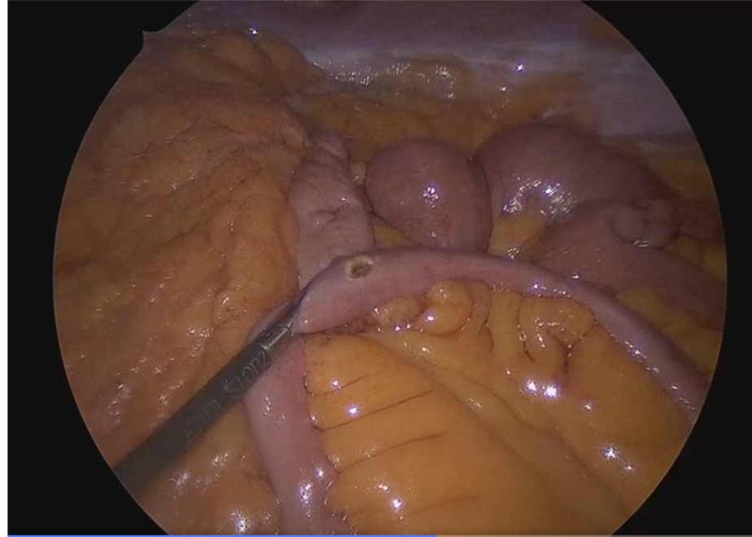

Slide 7
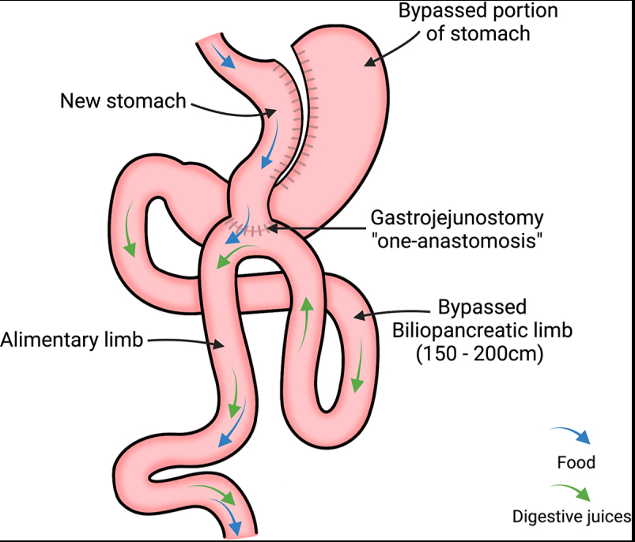

Slide 8
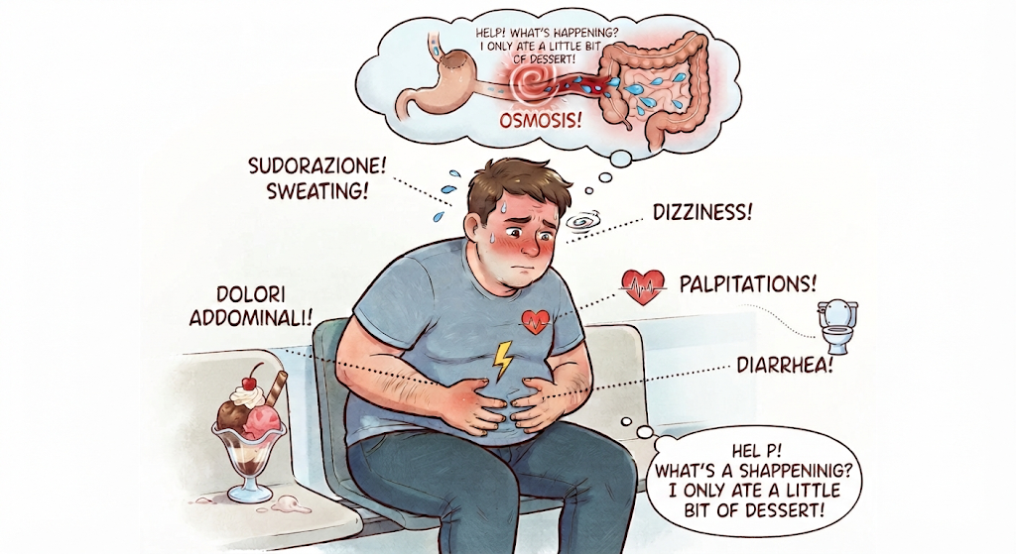

Slide 9
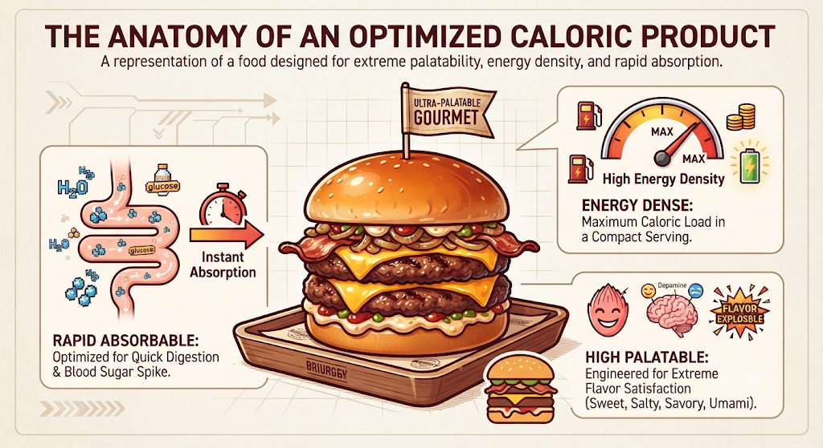

Slide 10
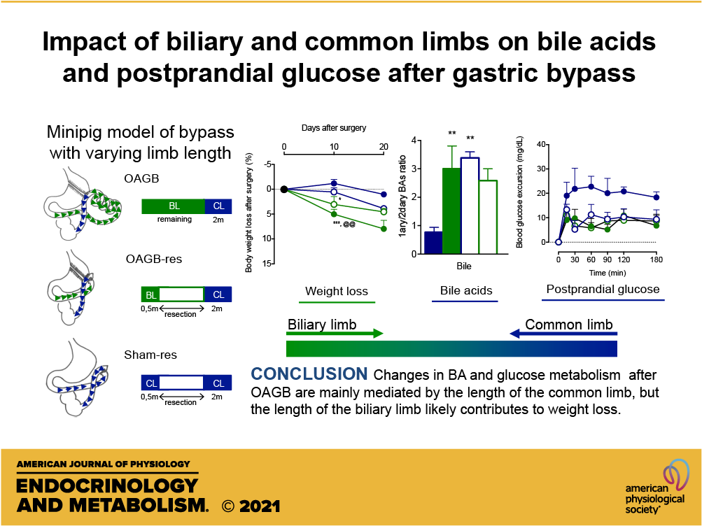

Slide 11
Bile Acids: What’s Really Going On?
The Dynamic Metabolic Benefits
Hormonal Surge: Altered anatomy forces bile acids to meet food much further down the small intestine. This delayed mixing spikes the systemic release of metabolic hormones like GLP-1 and PYY.
Glucose Control: Higher concentrations of circulating bile acids bind to specialized receptors (like TGR5 and FXR). This binding rapidly improves insulin sensitivity and helps resolve Type 2 diabetes independent of weight loss.
Energy Expenditure: Activated bile acid receptors signal the brain and adipose tissue to increase calorie burning and reduce overall appetite.

Slide 12
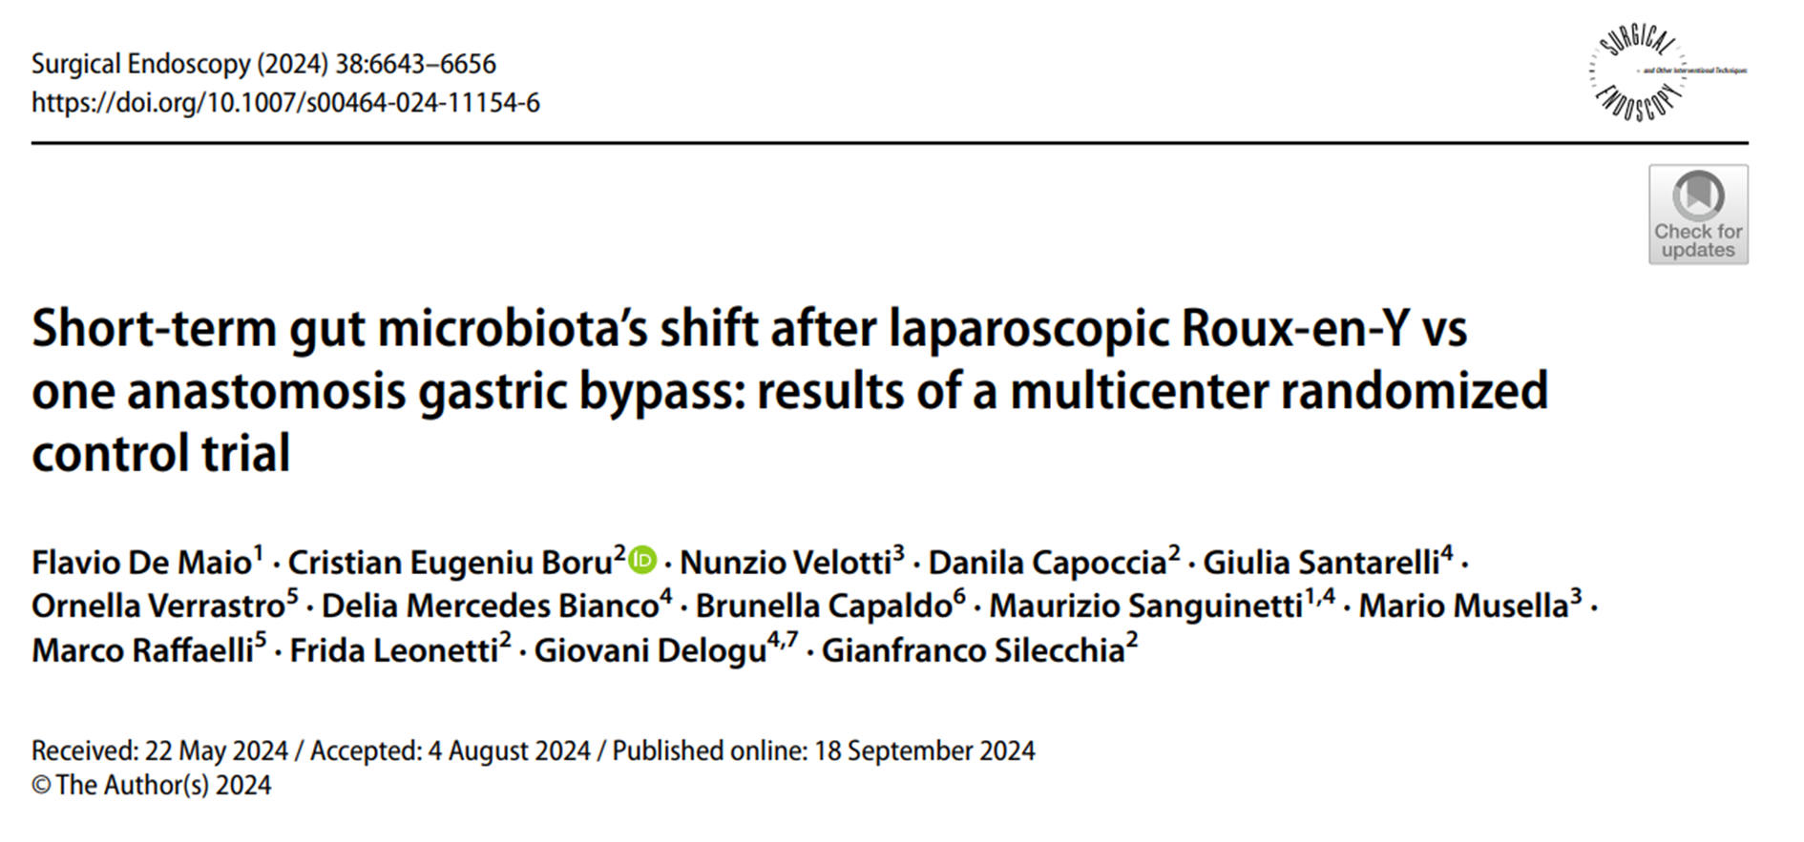

Slide 13

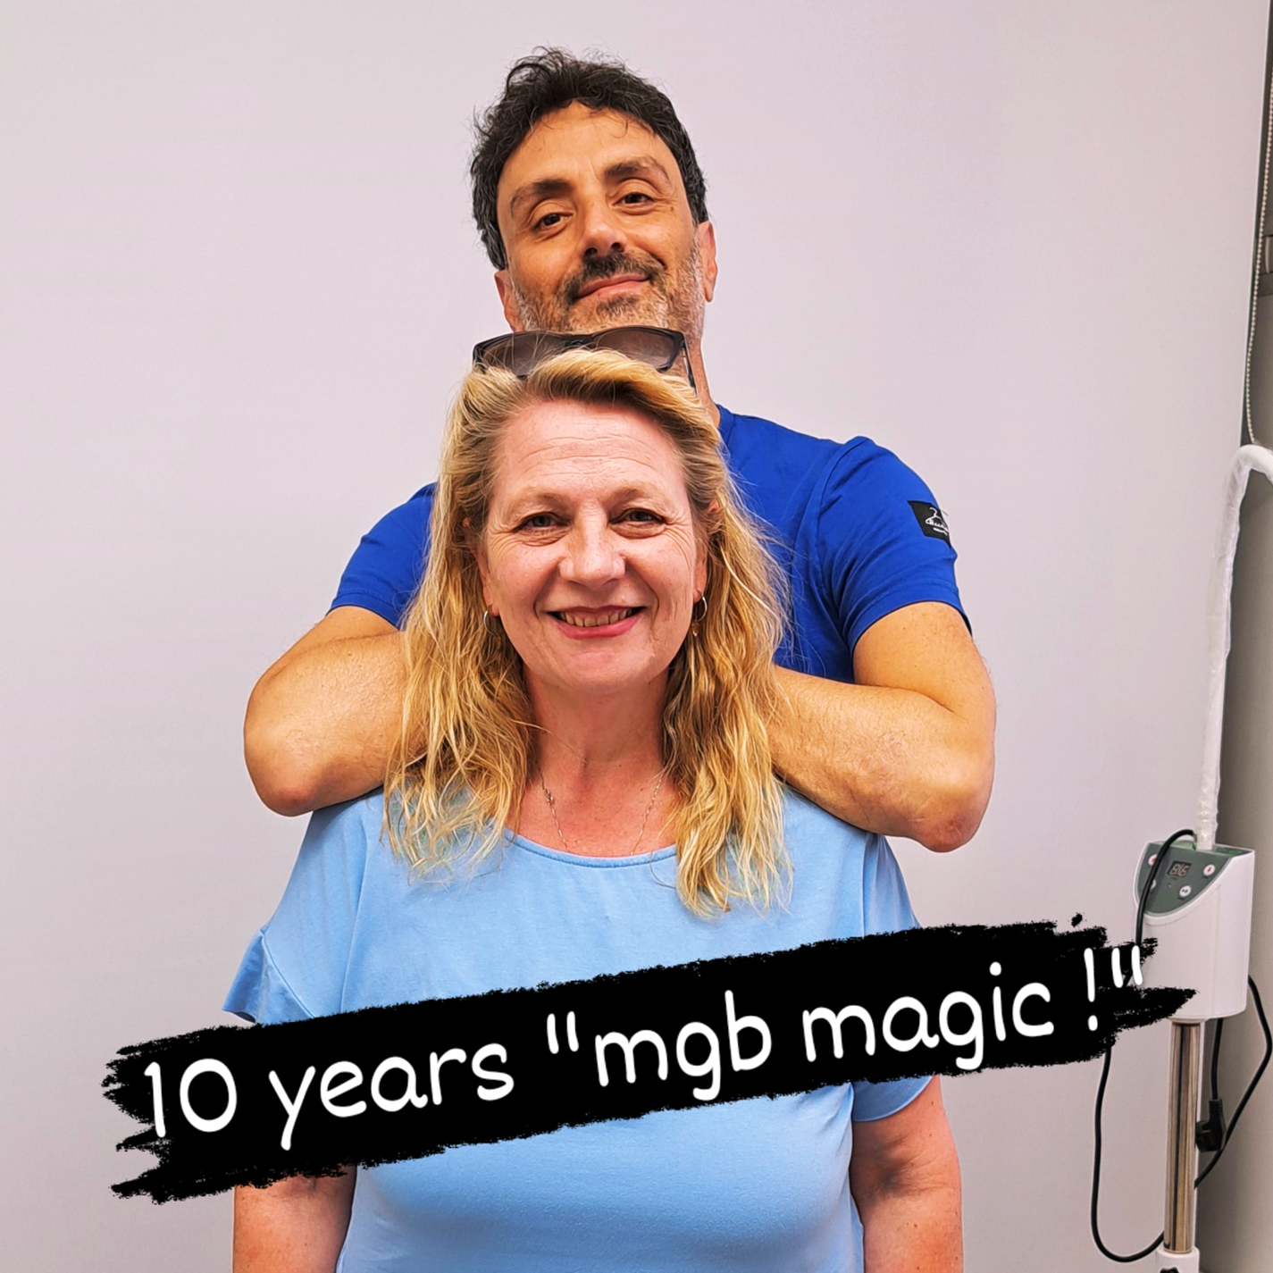
OAGB
10-years follow up
Francesco Greco
Director Bariatric & Metabolic Surgery Unit
Fondazione Poliambulanza Brescia-Italy
drgrecofra@hotmail.com
@obese.lives.matter

